Slide 1

Self-Supervised Learning
by Estimating Twin Class Distributions
2023. 01. 18
Presenter : Taewoong Kang
twk@deepnoid.com

Slide 2
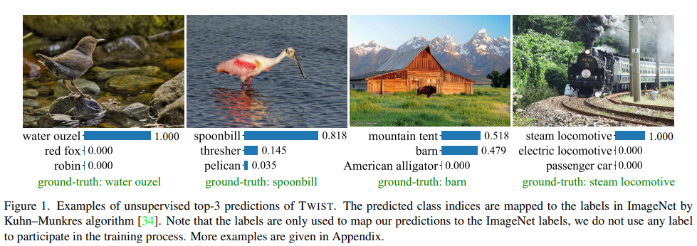
Abstract
Abstract
Self-Supervised Learning
Classifying large-scale unlabeled datasets in end-to-end way(employ a Siamese network)
Focused on enforcing the class distsribution of two different augmentations to be consistent
Simply minimizing divergence between augmentation
-> cause collapsed solution

Slide 3
Abstract
TWIST can avoid the collapsed solution
Collapsed solution
Outputting the same class probability distributions for all images
Maximize mutual information between the input and the class prediction
Maximizing the agreement of different augmentation
Pushing away the representation of different image based on the instance discrimination pretext task

Slide 4
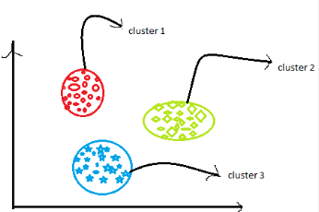
Related Work
Contrastive method
Learn an embedding space
Features of different augmentation from the same images are attracted
Features of different images are separated
Notes:
Contrastive 이전 -> design handcrafted auxiliary tasks(context prediction , colorization context encoder jigsaw puzzle rotation prediction

Slide 5
Related Work
Contrastive method
BYOL, SimSiam
Abandon the negative samples and design some special techniques
Such as asymmetric architecture, momentum encoder and stop gradients
Barlow Twins, VICReg
Learn informative representations
By reducing the redundancy or covariance of different dimensions

Slide 6
Related Work
Clustering-based method
Use clustering tool
To generate pseudo-labels for images and classify the images with the generated pseudo-labels
DeepCluster
K-means
SwAV
Sinkhorn-Knopp
DINO
Updates pseudo-targets using the output of the momentum teacher together with sharpening and centering operations
Self-Classifier
End-to-end method to classify unlabeled datasets
SCAN
Two-step approach to mainly focus on unsupervised classification task

Slide 7
Related Work
Mutual information maximization
Bridle, IMSAT, IIC, Deep InfoMax
Difference between Deep InfoMax and TWIST
The task to classify image by exploring their semantric relation
Information between images and a discrete random variable, instead of high-dim continuous representation
Do not require the neural estimator

Slide 8
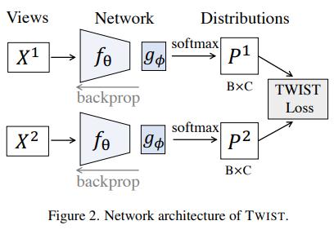
Method
Architecture
Siamese Network
X1, X2 are two augmented version of X
The outputs are two probability distribution over C categories

Slide 9
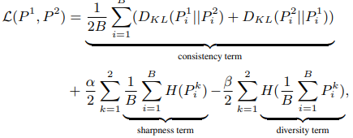
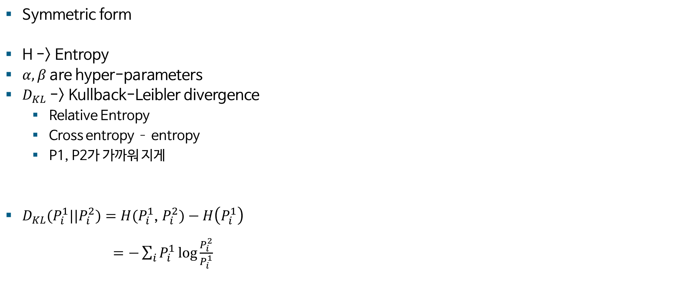
Method
Learning objective
Symmetric form
H -> Entropy
$α,β$ are hyper-parameters
$D_{KL}$ -> Kullback-Leibler divergence
Relative Entropy
Cross entropy – entropy
P1, P2가 가까워 지게
$D_{KL}(P_{i}^{1}||P_{i}^{2})=H(P_{i}^{1}$, $P_{i}^{2})−H\left(P_{i}^{1}\right)$
$=−\sum_{i}{P_{i}^{1}\log{\frac{P_{i}^{2}}{P_{i}^{1}}}}$

Slide 10
Method
Learning objective
Sharpening term
Minimize the entropy of class distribution for each samples to regularize the output distribution to be sharp
Makes each sample have a deterministic assignment
Diversity term
Make the predictions for different samples be diversely distributed
Maximizing the entropy of the mean distribution across different samples

Slide 11
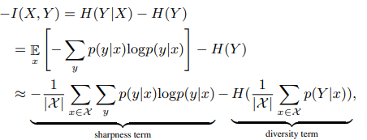
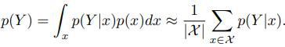
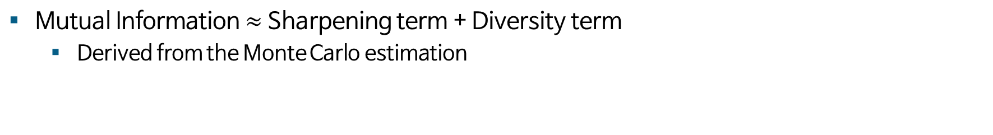
Method
Theoretical Explanation
Mutual Information $≈$ Sharpening term + Diversity term
Derived from the Monte Carlo estimation

Slide 12
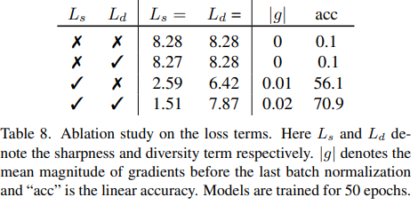
Method
Ablation Study on loss terms
Without sharpness term generate collapsed solutions
Without diversity term do not generate collapsed solution
But performances deteriorate significantly
Theoretically, will lead to collapsed solution
But the NBS helps avoid the problem
(can separate the probabilities in different column and force them to have a unit standard deviation)

Slide 13
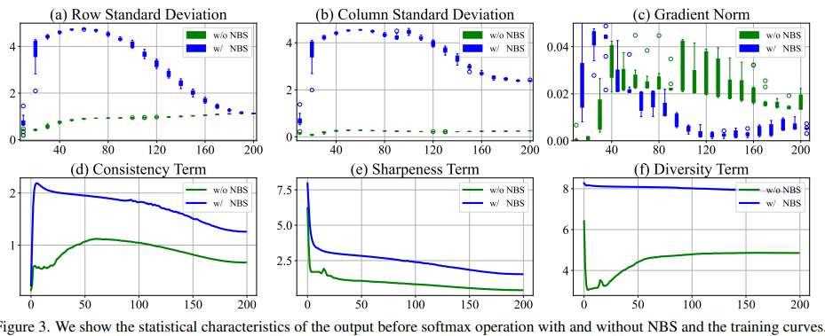
Method
Amplifying Variance for Better Optimization
Consistency, sharpness term are easy to minimize
But diversity term is difficult to maximize
Column Standard Deviation keeps small -> cause low diversity
To solve this problem -> add a batch normalization before the softmax to amplify the variance to force them to be separated =>5% improvement in ImageNet linear Classification

Slide 14
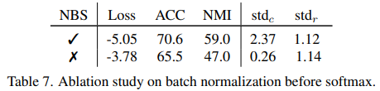
Method
Ablation Study on batch normalization before softmax
NBS(batch normalization before softmax)

Slide 15
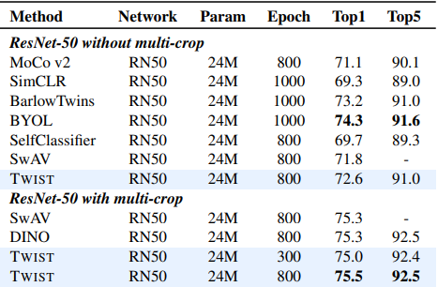
Training Strategy
Self-labeling for ResNets
The multi-crop strategy gaves the performance improvement of TWIST is much smaller than SwAV.
SwAV uses the global crops to generate accurate pseudo-labels as supervision to train the local crop
In TWIST, global and local crops are regarded same
=> add a self-labeling stage after the regular training

Slide 16
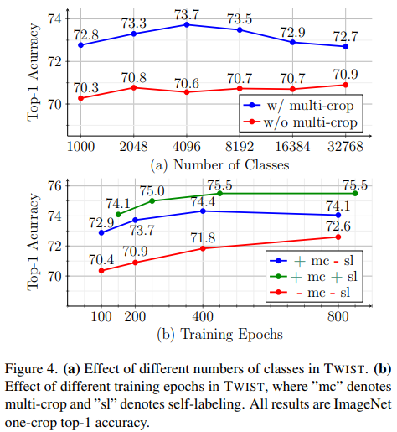
Training Strategy
Ablation Study on Multi-crop and Self-labeling

Slide 17
Training Strategy
Momentum Encoder for ViT
Adopt the momentum encoder design, which is widely adopted to train ViT-based models.
Although TWIST using ViT as backbone without momentum encoder can work well, we use it only for accuracy gains

Slide 18
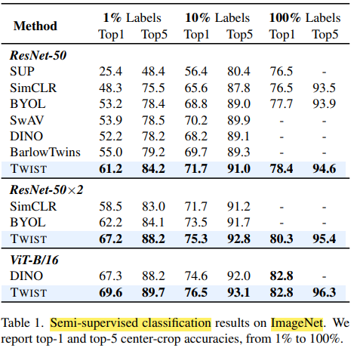
Main Result
Semi/Full-supervised Fine-tuning
Fine-tuned the pre-trained TWIST model on a subset of ImageNet
TWIST outperforms all other SOTA method by large margins

Slide 19
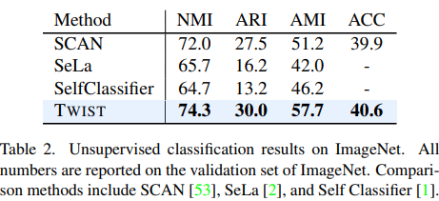
Main Result
Unsupervised classification
The outputs are directly mapped to the real labels by the Kuhn-Munkres algorithm

Slide 20
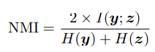
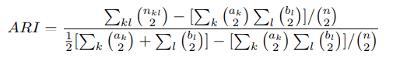
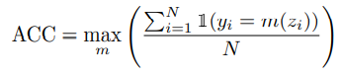
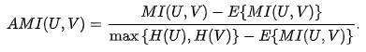
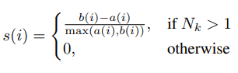
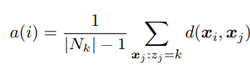
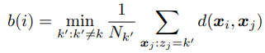
Main Result
Evaluation Metrics
1.NMI(normalized mutual information)
problem : does not penalize large cardinalities
(i.e., over clustering)
2. ARI(adjusted rand index)
The corrected-for-chance version of the Rand index
RI(rand index) quantifies the percentage of correct decision
3. ACC(accuracy)
The standard measure
4. AMI(adjusted mutual information)
5. Sillhouette Score
The more data points within each cluster are closely-packed and different clusters are well-separated

Slide 21
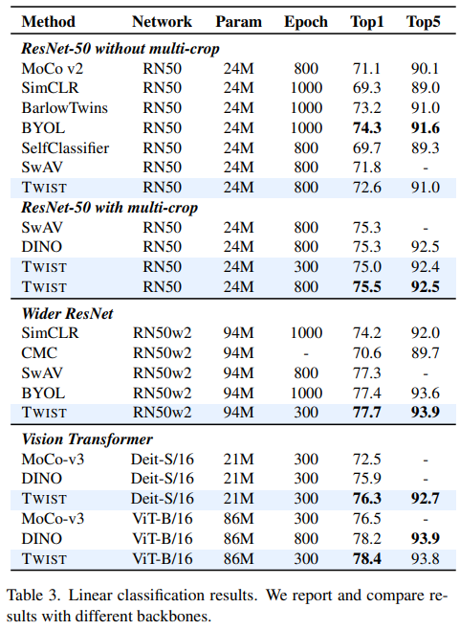
Main Result
Linear classification
TWIST outperforms other SOTA method
For wider ResNet50, also works well
ViT is very sensitive to hyper-parameters and training it is very costly
The performance of linear classification on ImageNet

Slide 22
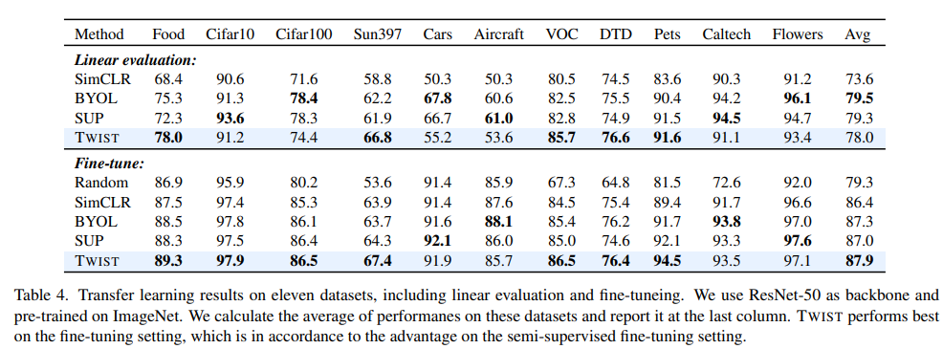
Main Result
Transfer Learning
The outputs are directly mapped to the real labels by the Kuhn-Munkres algorithm

Slide 23
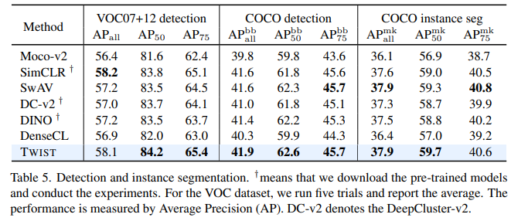
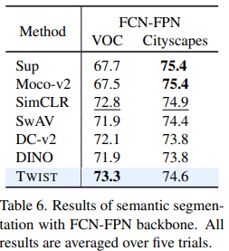
Main Result
Detection and Segmentation
Use ResNet-50 with FPN
For Pascal VOC, use Faster R-CNN
For MSCOCO, use Mask R-CNN
In implementation, use Detectron2
Using FCN as architecture
Use MMSegmentaion to train the architectures

Slide 24
Conclusion
Conclusion
TWIST is simple and theoretically explainable
Does not rely on any clustering tools
Limitation
Vulnerable to data distribution(tries to capture the intrinsic semantic structure)
With biased dataset, the model likely to learn malicious information
When using ViT, adopt momentum encoder
Performs best when the number of classes is 4096(with Multi-crop)

Slide 25
Q & A

Slide 26
감사합니다

